Slide 1
Error Detection and Correction

Slide 2
Error Detection and Correction
There are many reasons such as noise, cross-talk etc., which may help data to get corrupted during transmission.
Data-link layer uses some error control mechanism to ensure that frames (data bit streams) are transmitted with certain level of accuracy.

Slide 3
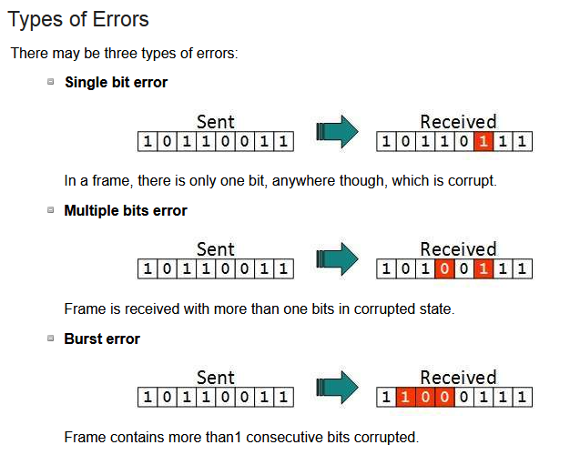
Error Detection and Correction

Slide 4
Error Detection and Correction
Redundancy
Central concept to detect or correct errors
Extra bit/bits with data
Added by sender
Removed by receiver
Detection
Looking only if any error has occurred
Correction
More difficult than detection
Exact number of corrupted bits are required along their location

Slide 5
Error Detection and Correction
Forward Error Correction
Receiver tries to guess the msg from redundant bits
Possible when errors is small
Retransmission
Receiver detects the error and asks the sender to resend
Resending is repeated until the arrival of error-free msg

Slide 6

Error Detection and Correction
Parity Check for Detection
One extra bit is sent along with the original bits to make number of 1s either even in case of even parity, or odd in case of odd parity.
The sender while creating a frame counts the number of 1s in it. For example, if even parity is used and number of 1s is even then one bit with value 0 is added. This way number of 1s remains even. If the number of 1s is odd, to make it even a bit with value 1 is added.

Slide 7
Error Detection and Correction
Parity Check for Detection
The receiver simply counts the number of 1s in a frame. If the count of 1s is even and even parity is used, the frame is considered to be not-corrupted and is accepted.
If a single bit flips in transit, the receiver can detect it by counting the number of 1s. But when more than one bits are erroneous, then it is very hard for the receiver to detect the error.

Slide 8
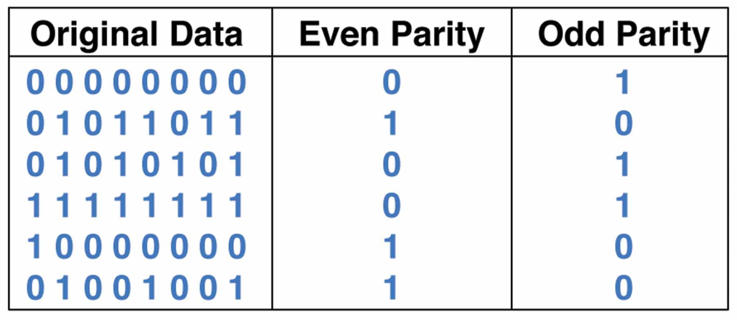
Error Detection and Correction
Parity Check for Detection

Slide 9
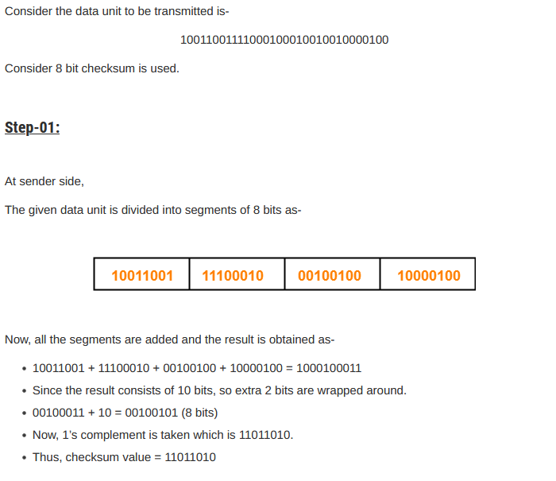
Error Detection and Correction
Checksum for Detection

Slide 10
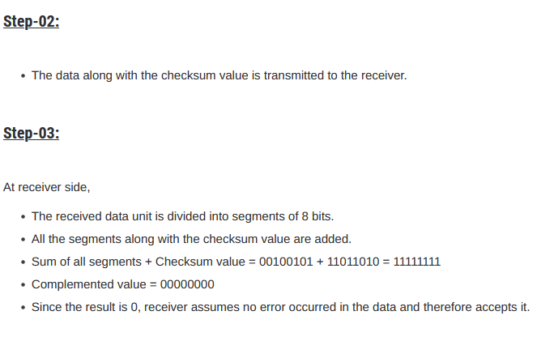
Error Detection and Correction
Checksum for Detection

Slide 11
Error Detection and Correction
Cyclic Redundancy Check (CRC) for Detection
This technique involves binary division of the data bits being sent.
The divisor is generated using polynomials.
The sender performs a division operation on the bits being sent and calculates the remainder.
Before sending the actual bits, the sender adds the remainder at the end of the actual bits.
Actual data bits plus the remainder is called a codeword.

Slide 12
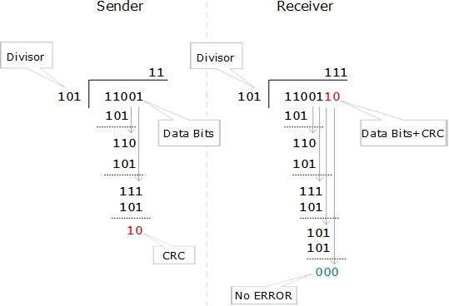
Error Detection and Correction
Cyclic Redundancy Check (CRC) for Detection

Slide 13
Error Detection and Correction
Cyclic Redundancy Check (CRC) for Detection
The polynomial is written in binary as the coefficients; a 3rd-degree polynomial has 4 coefficients (1x³ + 0x² + 1x + 1). In this case, the coefficients are 1, 0, 1 and 1. So, the divisor will be 1011

Slide 14
Error Detection and Correction
Block Coding
Redundancy is achieved through various coding schemes
Coding schemes may be block coding or convolution coding
In block coding, message is divided into blocks
Each blocks of k bits is called datawords
Redundant r bits are added with each block where n=k+r
Resulting n-bit blocks are called codewords
Block coding process is one-to-one

Slide 15
Error Detection and Correction
Hamming Code
Single bit error correction method
Algorithm of Hamming code:
An information of ‘k' bits are added to the redundant bits(parity) ‘p' to form k+p
The location of each of the (k+p) digits is assigned a decimal value.
The ‘p' bits are placed in the positions 1,2,.....2^{k-1}.
At the receiving end, the parity bits are recalculated. The decimal value of the parity bits determines the position of an error.

Slide 16
Error Detection and Correction
Hamming Code
Number of parity bits
Number of parity bits will be calculated by using the data bits:
2^{P} >= k + P +1
Here, k represents the number of message bits in the data string.
P represents number of parity bits.
For example, if we have 4 bit data string, i.e. k = 4, then the number of parity bits to be added can be found by using trial and error method.
Let’s take P = 2, then
2^{P} = 2² = 4 and k + P + 1 = 4 + 2 + 1 = 7 which violates the actual expression.
So let’s try P = 3, then
2^{P} = 2³ = 8 and k+ P + 1 = 4 + 3 + 1 = 8
So we can say that 3 parity bits are required to transfer the 4 bit data with single bit error correction.

Slide 17
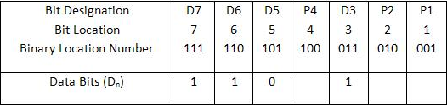
Error Detection and Correction
Hamming Code
Where to Place these Parity Bits?
The parity bits have to be located at the positions of powers of 2 that is at 1, 2, 4, 8 and 16 etc. Therefore the codeword after including the parity bits will be like this for 4 message bits:
D7, D6, D5, P4, D3, P2, P1
For message bit 1101, data bits will be like following:

Slide 18
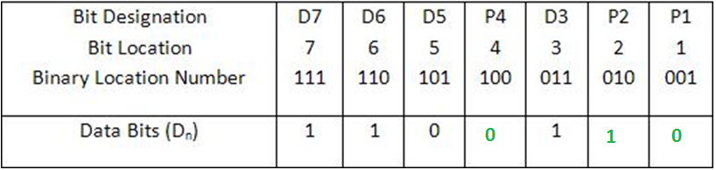
Error Detection and Correction
Hamming Code
P1-> D3 ⊕ D5 ⊕ D7
P2-> D3 ⊕ D6 ⊕ D7
P4-> D5 ⊕ D6 ⊕ D7
After adding parity bits:

Slide 19

Error Detection and Correction
Hamming Code
What about if message code is 1010?
P1-> D3 ⊕ D5 ⊕ D7
P2-> D3 ⊕ D6 ⊕ D7
P4-> D5 ⊕ D6 ⊕ D7
After adding parity bits:
What will happen if 4th bit changes from 0 to 1 at receiver end?

Slide 20
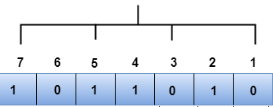
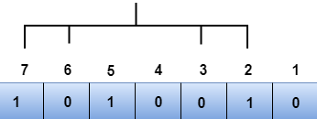
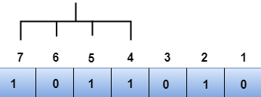
Error Detection and Correction
Hamming Code
P1
P2
P4

Slide 21
Error Detection and Correction
Hamming Code
Binary representation of P4P2P1 = 100 = 4 in decimal value
So, there is an error in 4th bit
The bit position have error put 1 there
Calculated | 0 | 0 | 0 | 1 | 0 | 0 | 0
Received | 1 | 0 | 1 | 1 | 0 | 1 | 0
Corrected | 1 | 0 | 1 | 0 | 0 | 1 | 0

Slide 22
Error Detection and Correction
Hamming Code
Exercise: Generate Hamming code for the message 01101
Notes:
Result: 001100110

